Slide 1
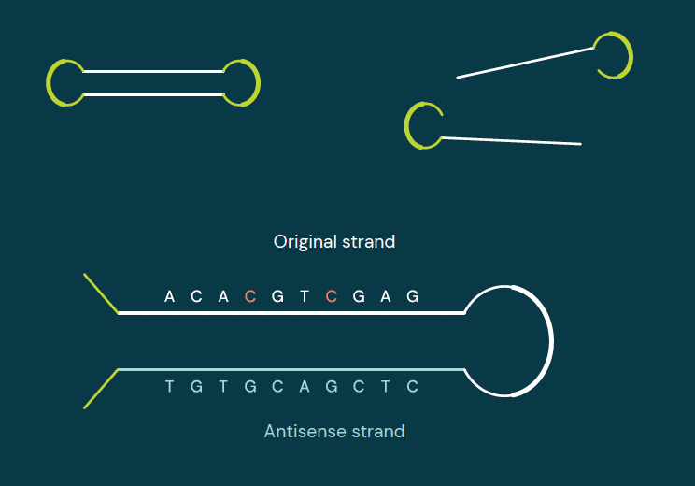
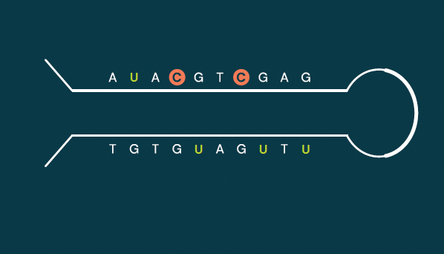
Obtaining genetic & epigenetic data simultaneously with duet multiomics solution +modC.
Hairpin adapters and replication
DNA fragments are connected with hairpin adapters. Then the antisense strand is replicated and replaced with the copy strand before adding sequencing adapters.
Move beyond the limitations of A-C-G-T genetic sequencing.
Our two-base coded biochemistry and novel bioinformatic software reveals precise methylation information in context, combining epigenetic and genetic data in a single, highly accurate readout.
Here’s how five letter sequencing works.
Protecting modified cytosines,
then deamination
Enzymatically protecting methylated cytosines, then deaminating unprotected C to U clearly distinguishes modified from unmodified C.

Slide 2
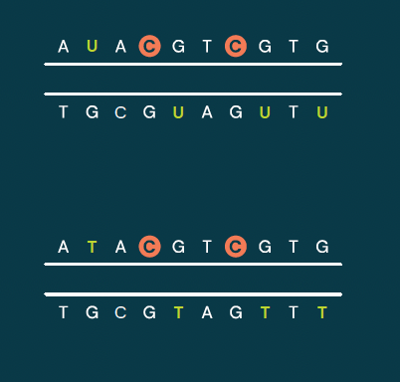
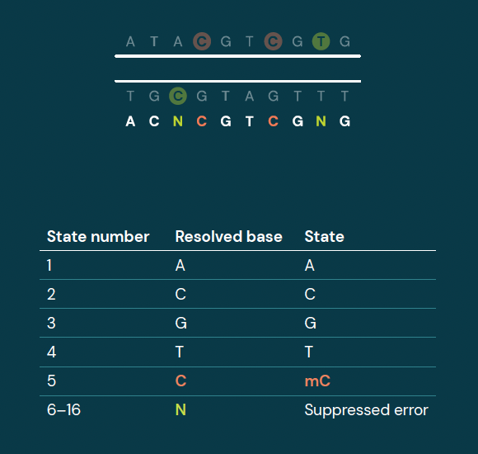
Obtaining genetic & epigenetic data simultaneously with duet multiomics solution +modC.
Paired-end reading and base
calling
The hairpin is opened for sequencing and read from both ends. The two reads are then integrated, with 2-letter bases resolved into A, C, modC, G or T.
Move beyond the limitations of A-C-G-T genetic sequencing.
Our two-base coded biochemistry and novel bioinformatic software reveals precise methylation information in context, combining epigenetic and genetic data in a single, highly accurate readout.
Here’s how five letter sequencing works.
Decoding and simultaneous read
PCR and sequencing errors are automatically suppressed by the two-base readout. This also enables simultaneous detection of genetic base and methylation status at each position.

